Slide 1
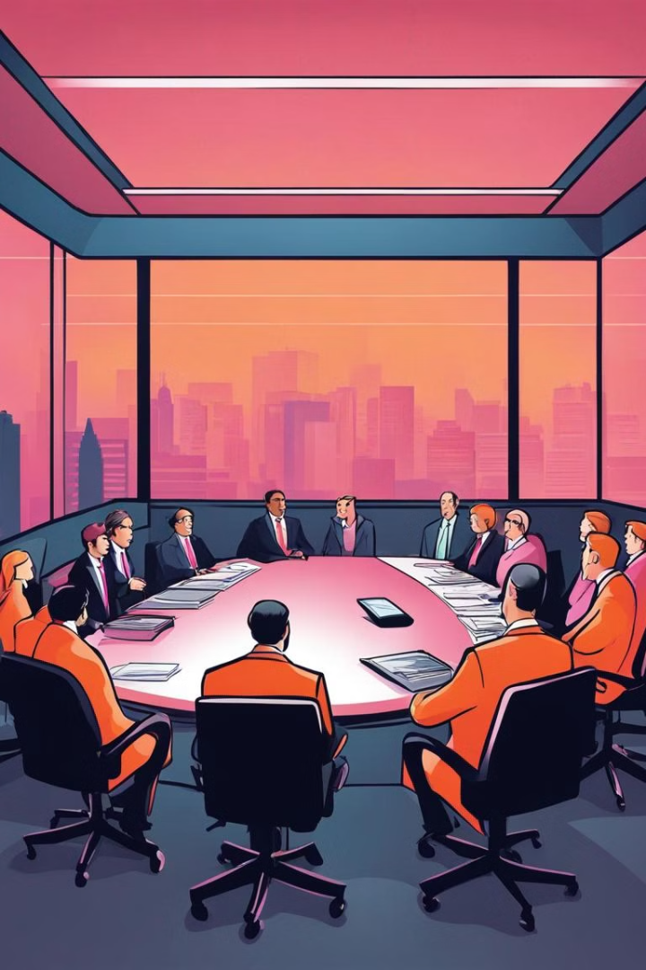
Mismanagement of People's Money by the Indian Govt
Prepared By:
Hassan Shaikh - 210429
Saad Shah - 210446
Adnan Shaikh - 210450
Abdurrahman Qureshi - 210451
Guided By: Mr Yahya Ansari
M.H. Saboo Siddik Polytechnic

Slide 2
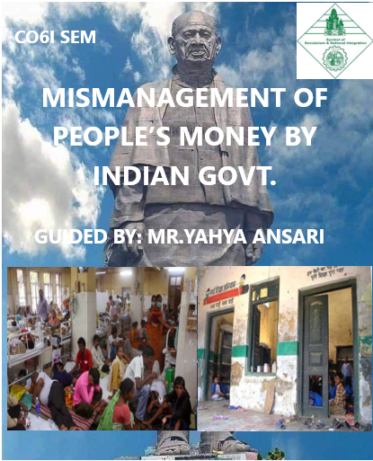
Introduction
Despite the pressing needs of millions of rural Indian households lacking basic necessities such as clean drinking water, electricity, and sanitation, government priorities often seem misplaced.
A recent government survey revealed that 82% of rural Indian households do not have access to these essential services.
In India, basic facilities like roads, education, health, etc. are in very poor conditions but still the govt. makes decisions that are unhelpful and unfavourable.

Slide 3
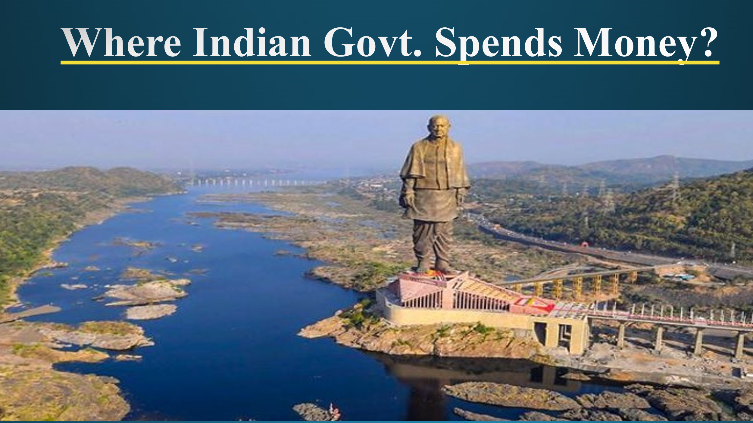
The Indian government's expenditure on specific projects or initiatives, often viewed as extravagant or not aligned with public priorities, has sparked widespread criticism and debate.
The high-cost infrastructure projects and lavish statues have raised questions about the allocation of taxpayer funds. Concerns are also raised about the financing of political campaigns and events, potentially diverting resources from essential services.
This scrutiny reflects a broader discourse on transparency, accountability, and the need for government spending to align closely with the welfare and development needs of the public.

Slide 4

The Indian government’s. President Trump, accompanied by wife Melania and a high-level delegation, visited India earlier this week.
During their 36-hour visit, President Trump and the first lady attended various events and visited two cities - Ahmedabad and Agra - besides the national capital of India. Ads by Upon their arrival at Ahmedabad airport on Monday, the US first couple was accorded a warm welcome by Prime Minister Modi and thousands of people who had lined up on the streets of the city.
Ind govt Spend more than 120 crores in all these inauguration.

Slide 5
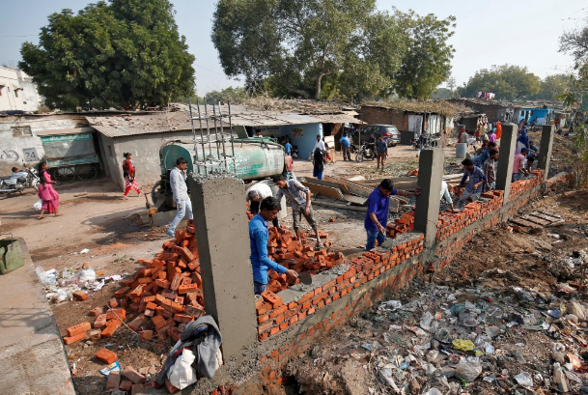
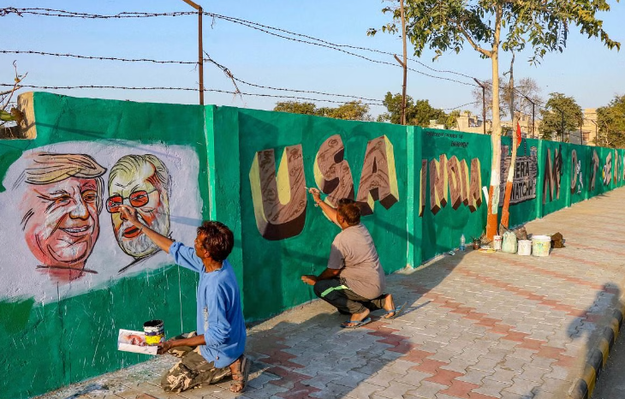
Urban Realities: Govt Building walls to hide the slums
To hide the slums from the American president's view, the Indian government built huge walls in front of them.
Critics argue that instead of investing in hiding the slums, the government should have focused on developing them, addressing the root causes of poverty and inequality.
If the government would have invested their money in developing these slums there would never have been a need to build these huge walls just to hide them.

Slide 6
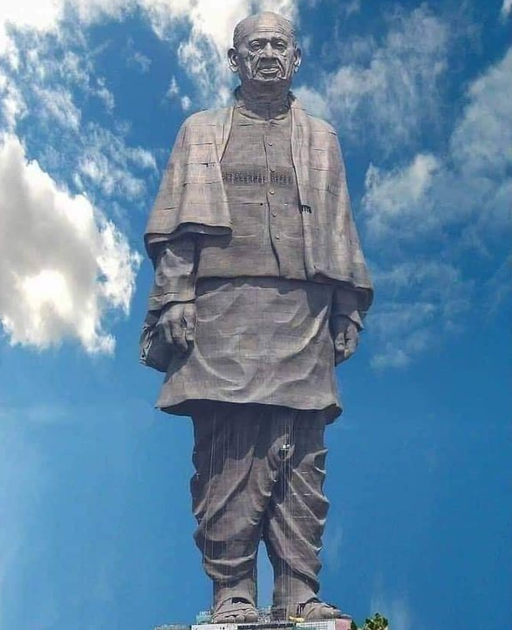
Statue of Unity
The Statue of Unity, standing as the world's tallest statue at 182 meters, symbolizes the leadership of Vallabhbhai Patel in uniting India's princely states. However, its construction at a cost of ₹2,700 crore has sparked debate over the government's spending priorities.
Instead of making such lavish projects, while symbolically significant, do not address pressing issues faced by many Indians, such as poverty, infrastructure, and healthcare.
This reflects a pattern where public funds are allocated to projects of questionable utility, raising concerns about fiscal responsibility. There are plenty of sectors in India, like health, safety, employment and education where all this money could have been utilized.

Slide 7

Unveiling the Veil: The Misuse of Taxpayer Funds in Indian Governance
The Indian government has been accused of diverting taxpayer funds to finance political campaigns and initiatives that serve their own partisan interests, rather than the greater public good.
Investigations have uncovered instances where government funds were channeled to support specific political parties, finance lavish rallies and events, and maintain the power structures of the ruling elite. This undermines the principles of transparency and accountability that are essential for a healthy democracy.

Slide 8



Inadequate Investment in Infrastructure and Economic Development
Neglected Roads
1
Crumbling highways and congested traffic hinder economic mobility.
Outdated Power Grid
2
Frequent blackouts and unreliable electricity stall industrial growth.
Lack of Broadband
3
Slow internet access limits innovation and technological advancement.
The Indian government's failure to invest adequately in critical infrastructure projects has stunted the country's economic development.

Slide 9
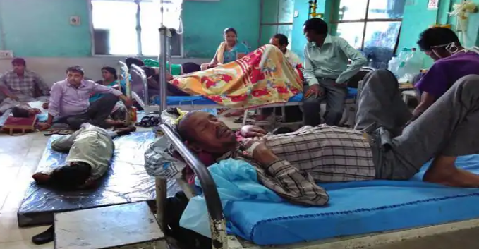
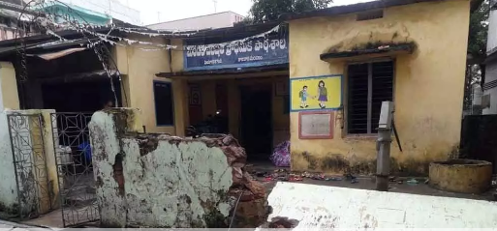
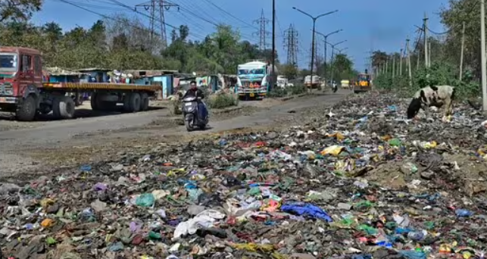
Diversion of Funds from Critical Public Services
1
Neglected Healthcare
Funds meant for improving public healthcare infrastructure and services are often diverted to other government programs, leaving hospitals underfunded and unable to provide quality care to citizens.
2
Deteriorating Education
Crucial funds earmarked for upgrading schools, providing teacher training, and improving educational resources are frequently siphoned off, leading to a decline in the quality of public education.
3
Crumbling Infrastructure
Money intended for building and maintaining roads, bridges, and other critical public infrastructure is misused, resulting in a deteriorating transportation network that undermines economic growth and development.

Slide 10
Conclusion
The mismanagement of public funds by the Indian government has had severe repercussions for the common people, particularly the underprivileged.
The diversion of resources from critical public services has deprived many of access to basic necessities, while excessive spending on inefficient programs has burdened low-income families with heavy taxes. The failure to address corruption and cronyism has only worsened the situation.
Moving forward, there is a need for greater transparency, accountability, and equitable distribution of resources to ensure that public funds are used efficiently and effectively for the benefit of all citizens.

Slide 11
THANKING
YOU

